Slide 1
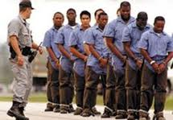
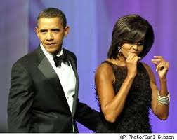
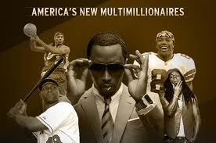
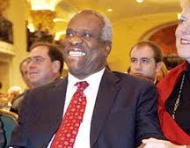
IN
THE
BOX

Slide 2
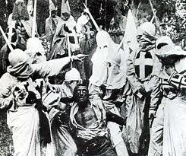
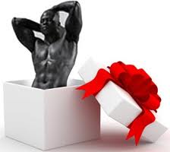
IN THE BOX
Abdul Alkalimat
Department of African American Studies
University of Illinois

Slide 3
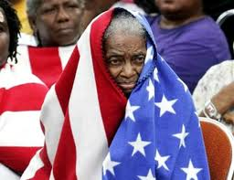
DIALECTICS OF BLACK PEOPLE AND THE BOX
OUT
1787
1791
IN
1941
1944
1954
1964
1965
IN
1865
1868
1870
1875
OUT
1883
1896
Wassup?

Slide 4
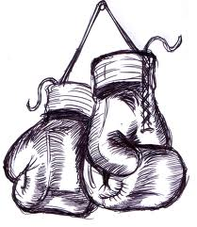
OUT
1787
1791
Slavery
IN
1865
1868
1870
Abolitionism, The Civil
War, and Reconstruction
OUT
1896
National oppression
IN
1941
1944
1954
1964
1965
Civil Rights Movement
“without struggle there is no progress.”

Slide 5
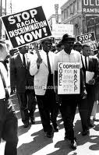
IN THE BOX:
20TH Century Civil Rights Movement
The Organization of the
Movement in time,
space, and force
The “action-synthesis” of
the movement, its
major campaigns

Slide 6
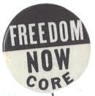
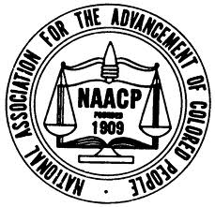
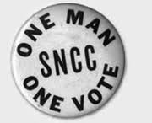
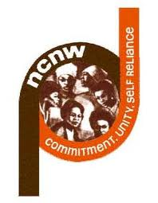



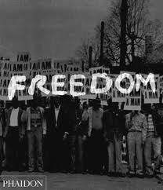
20th Century Civil Rights Organizations
NAACP: National Association for the Advancement of Colored People
NUL: National Urban League
NCNW: National Council of Negro Women
CORE: Congress of Racial Equality
SCLC: Southern Christian Leadership Conference
SNCC: Student Nonviolent Coordinating Committee

Slide 7
NAACP

Slide 8
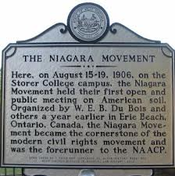
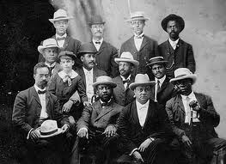
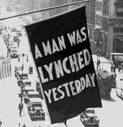
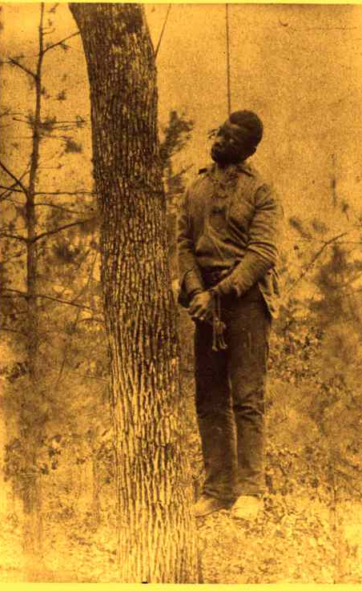
The Niagara Movement that
led to the NAACP (1905-1910)

Slide 9
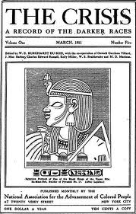
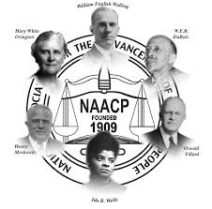
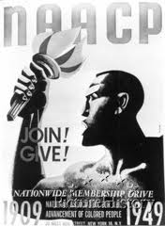
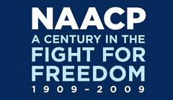
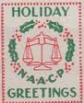
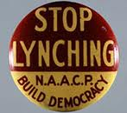
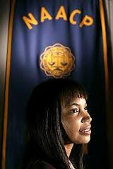
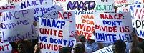

Slide 10
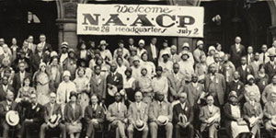
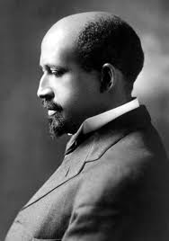
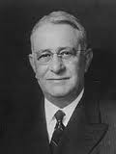
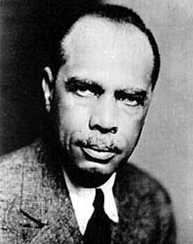
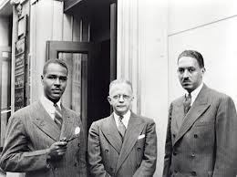

Slide 11
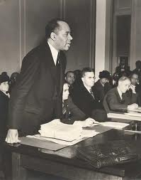
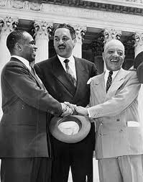
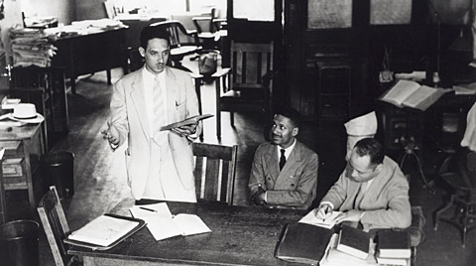
Charles Houston
(1895-1950)
Harvard Law
Review
Dean
Howard Law
Thurgood Marshall
(1908-1993)
NAACP Legal Defense Fund
Supreme Court Justice
(1967-1991)

Slide 12
Urban League

Slide 13

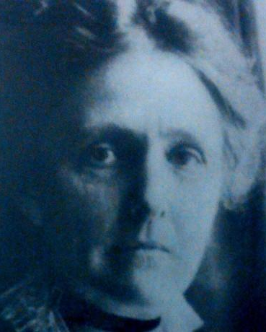
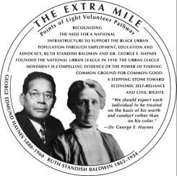
Founders of the
National Urban league
1911
The social workers
Responding to the
Great Migration
George E. Hayes
(1880 – 1960)
Ruth S. Baldwin
(1863 – 1934)

Slide 14
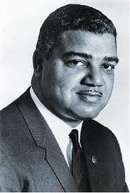
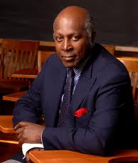
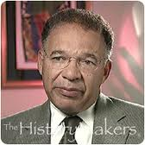
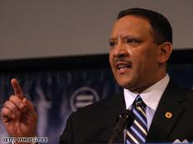
Mission: "to enable African Americans to secure economic self-reliance, parity, power and civil rights."
Today, more than 100 local affiliates of the National Urban League are located in 35 states and the District of Columbia.
Vernon Jordan
Whitney Young
(Hugh Price)
Marc Morial

Slide 15
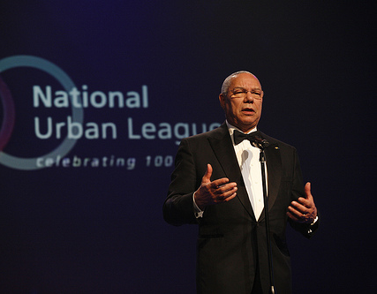
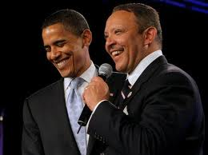
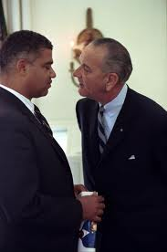
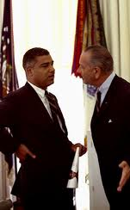
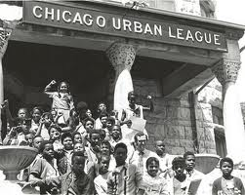
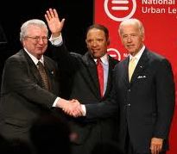

Slide 16
Board officers of the
National Urban league
CHAIR
John D. Hofmeister
Founder and CEO
Citizens for Affordable Energy
SENIOR VICE CHAIR
Robert D. Taylor
Founding Partner
Centinela Capital Partners
VICE CHAIR
The Honorable Alexis M. Herman
President
New Ventures
SECRETARY
Paul McKinnon
Head of Human Resources
Citigroup, Inc.
TREASURER
Jon R. Campbell
Executive Vice President,
Director of Social Responsibility Group
Wells Fargo & Company
ALL THE WAY IN THE BOX

Slide 17
National Council
of Negro Women

Slide 18
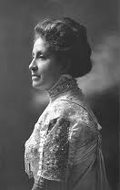
“Through the National Association of Colored Women, which was formed by the union of two large organizations in July, 1896, and which is now the only national body among colored women, much good has been done in the past, and more will be accomplished in the future, we hope. Believing that it is only through the home that a people can become really good and truly great, the National Association of Colored Women has entered that sacred domain. Homes, more homes, better homes, purer homes is the text upon which we have been preached.”
Mary Church Terrell (1863 – 1954)

Slide 19
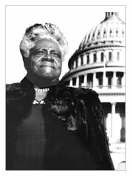
Founder, National Council of Negro Women
“It is our pledge to make a lasting contribution to all that is finest and best in America, to cherish and enrich her heritage of freedom and progress by working for the integration of all her people regardless of race, creed, or national origin, into her spiritual, social, cultural, civic, and economic life, and thus aid her to achieve the glorious destiny of a true and unfettered democracy.”
Mary Mcleod Bethune
1875 - 1955
(NCNW, 1935)

Slide 20
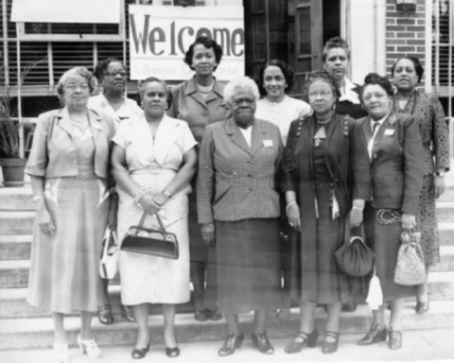
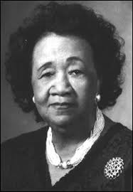
Dorothy Height
(1912 – 2010)
“I believe we hold in our hands the power once again to shape not only our own but the nation's future -- a future that is based on developing an agenda that radically challenges limitations in our economic development, educational achievement and political empowerment. Undoubtedly, African-Americans will have an integral role to play, although our path ahead will continue to be complex and difficult.”
In l957, Height was elected fourth National President of NCNW and served until l998 when she became Chair and President Emerita.

Slide 21
CORE

Slide 22



At the University of Chicago the
Fellowship of Reconciliation
was the pacifist organization
that led to CORE. They practiced
non-violent direct action in teams
that included Blacks and whites.

Slide 23







Slide 24








Slide 25
SCLC

Slide 26




Rosa Parks
(1913 – 2005)
The arrest of Rosa
Parks set off the
Montgomery Bus
Boycott and the
founding of SCLC

Slide 27




Slide 28






Slide 29







Slide 30


Andrew Young (1932 - )
Executive Director of SCLC, Congressman from Atlanta,
UN Ambassador, Mayor of Atlanta, member of The
Trilateral Commission
Again, all the way up into the box

Slide 31
SNCC

Slide 32





Greensboro Sit-Ins that
led to SNCC (2/1/60)

Slide 33




SNCC

Slide 34



SNCC focused on the
hardest goals – public
accommodations and
political power

Slide 35





Slide 36
Table on the six organizations

Slide 37




There remains two tendencies in the box

